Slide 1
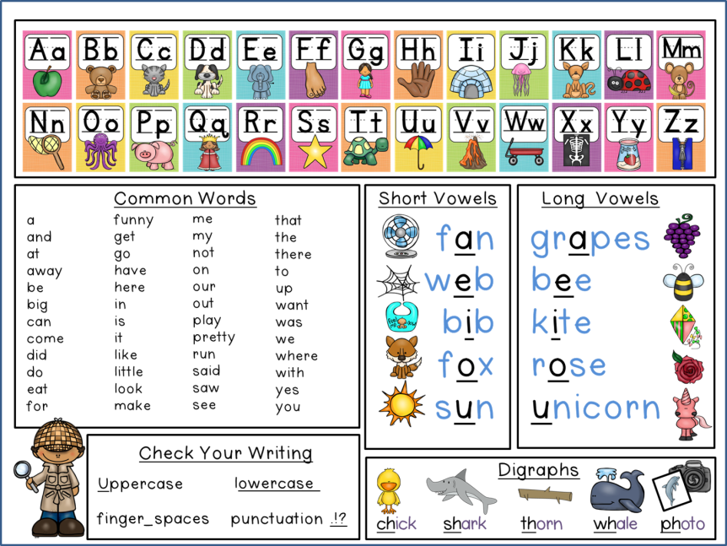
Desk Helper

Slide 5
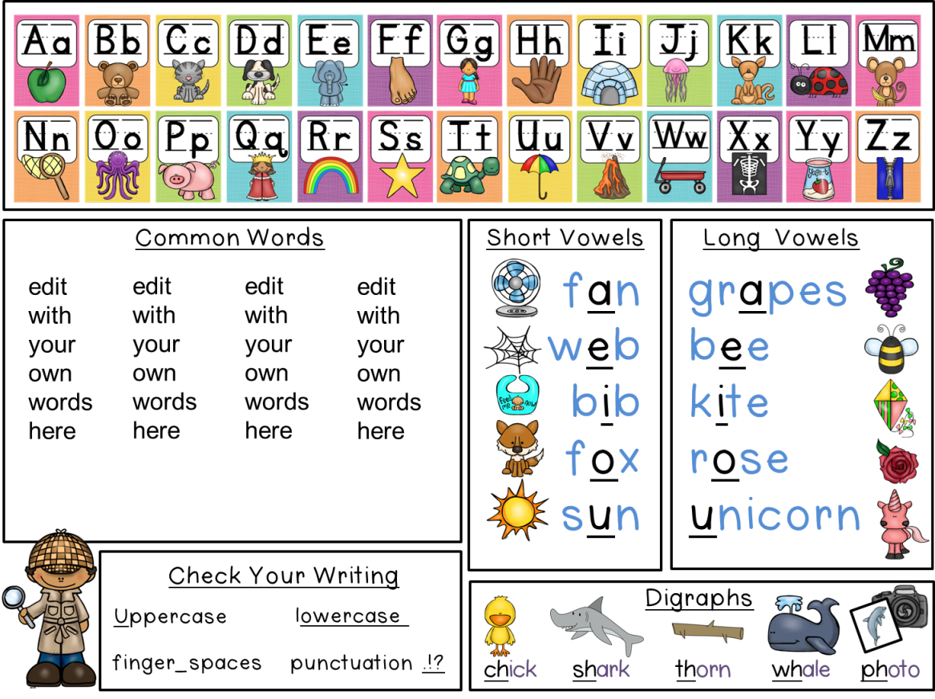
Editable Page
The next page is identical, except for the blank common words area. You can type the words that you require in the space.
Type your
own words

Slide 6
edit
with
your
own
words
here
edit
with
your
own
words
here
edit
with
your
own
words
here
edit
with
your
own
words
here

Slide 7
Alternate Spelling
The next page is identical, except for one spelling change.
It has color spelled as “colour.”

